Slide 1
caArray User Community Meeting
2.0 Release and Next Steps
Call in: 877-416-5524
Participant Passcode: 2627056
Centra: http://ncicb.centra.com
Meeting ID: array_feb6
February 6, 2008

Slide 2
Agenda
2.0 Release
  Features
  Known issues
  1.6 and data migration
Release planning
  2.0.1
  2.1.0

Slide 3
caArray 2.0 Release
caArray 2.0 release is now available!
Released items include:
  NCICB installation: https://array.nci.nih.gov
    Many array designs pre-loaded
  Distribution package and source code for local installers
  http://gforge.nci.nih.gov/frs/?group_id=305
  Documentation
    User Guide
    Installation Guide
    Technical Guide
    Release Notes

Slide 4
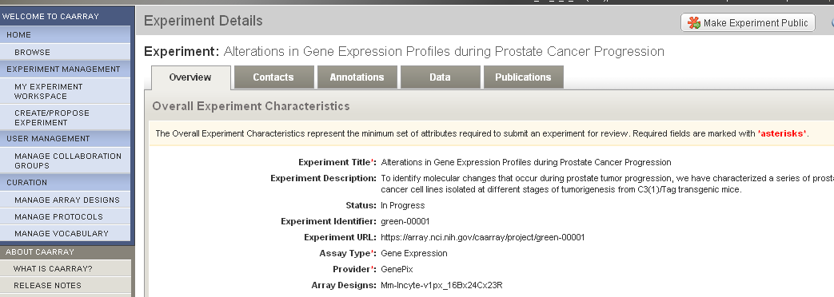
Create and annotate Experiments

Slide 5
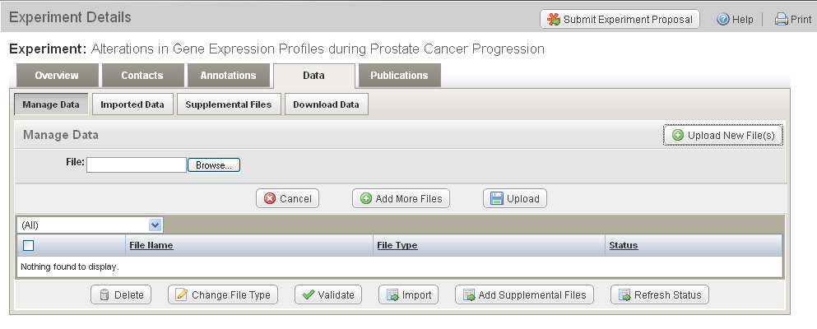
Upload, Validate, Import

Slide 6
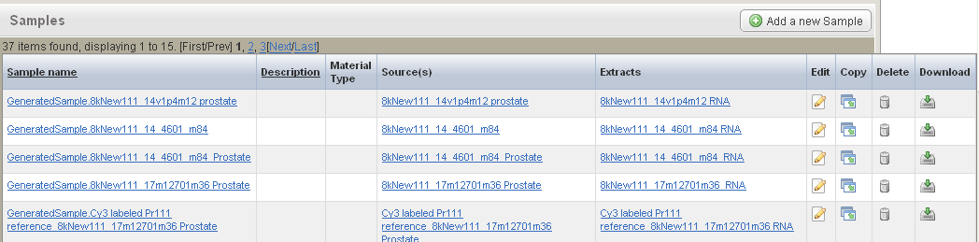
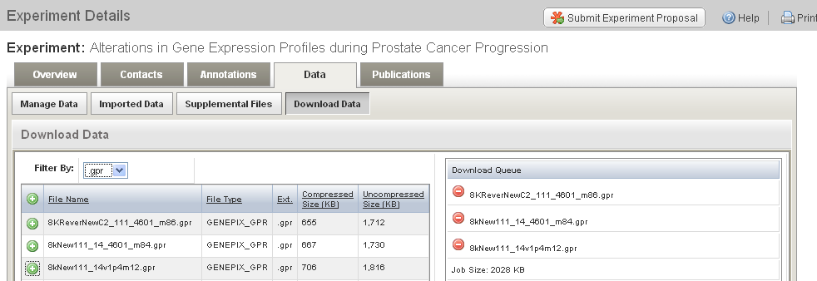
Download data
Lll

Slide 7
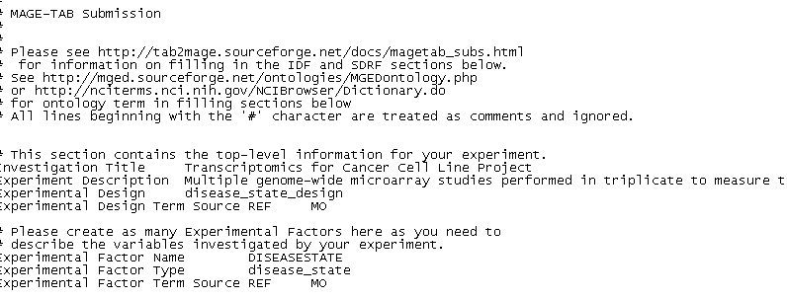
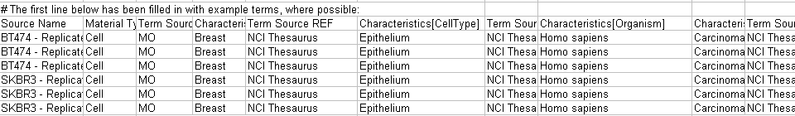
Import MAGE-TAB
IDF
http://www.mged.org/mage-tab/
SDRF

Slide 8
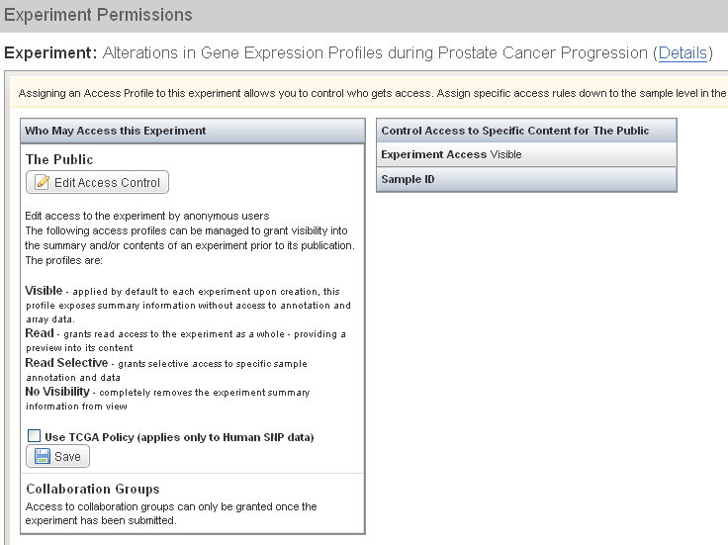
Permissions

Slide 9
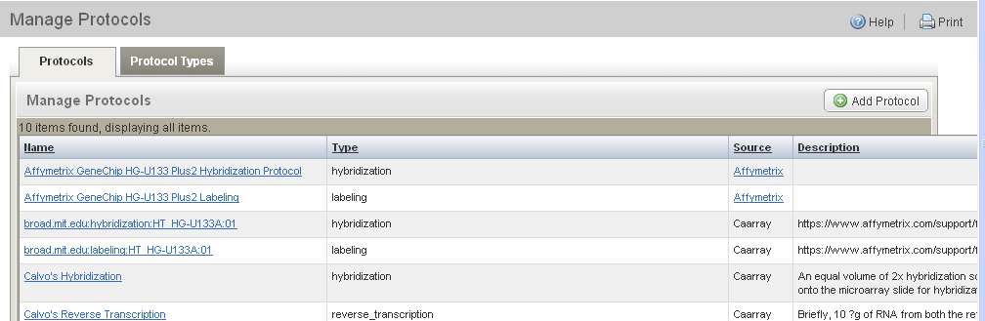
Manage Vocabularies, Protocols, Array Designs

Slide 10
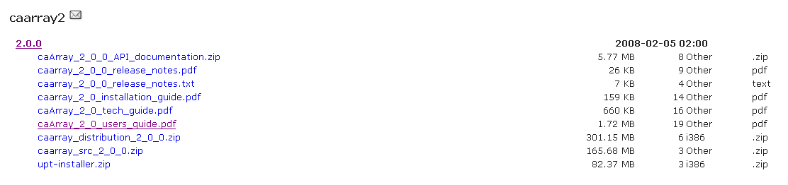
Installer

Slide 11
Known issues in caArray 2.0
Illumina SNP data: A bug was found in the Illumina SNP data parser preventing the annotation files (*.csv) from being loaded
Affymetrix Exon arrays: currently Affymetrix Human Exon 1.0 ST array can not be read by the AffxFusion jar
Data upload: The ability to upload files is restricted to files (raw or compressed) of 2 GB or less. It is highly encouraged that upload jobs are no larger that 1 GB.
"Retract Public Experiment”: Doesn't remove ability to download data -- work around is that when the experiment is retracted from public visibility and becomes editable, a user can click "Permissions" and change the visibility from "Read" to "Visible"

Slide 12
Known issues in caArray 2.0 (con’t)
Importing IDF, SDRF, and data files without defining Array Design in Experiment Overview: For all Affymetrix, Illumina and Genepix experiments where you want to validate and import MAGE-TAB data, you must select the array design to go with it or add the array design and then select it in order for validation and import to be successful.
SDRF file does not validate if data files are uploaded first: Currently unable to validate SDRF's that reference data already uploaded or imported. Remove references to such data from the SDRF, or delete referenced uploaded or imported data, and it should import smoothly.

Slide 13
caArray 1.6 and data migration
We have converted caArray 1.6 to be read-only – to be deployed by the end of the week.
1.6 will be kept up for at least 6 months – longer if needed by the community
A MAGE-TAB exporter has been created that we are using to migrate the data from 1.6 >>2.0
  Example migrated experiment: https://array.nci.nih.gov/caarray/project/green-00001
  Curation of the MAGE-TAB is needed before loading the data into 2.0, so this will be gradual process
Local installers of 1.x who would like to migrate their data to 2.0 should contact me to discuss support for this effort.

Slide 14
Additional resources under development
Training materials and training session
  Anticipated to be available in 2-3 weeks
MAGE-TAB support artifacts
  Provide templates and associated documentation
    MAGE-TAB is a flexible format and we would like to provide templates that that specify fields that are important for the caArray 2 interface

Slide 15
caArray 2.0.1
Maintenance release to address known issues in the 2.0 release, including
  Illumina SNP arrays
  Retraction of Public Experiments
  Others as time allows
  Any other issues that are identified as the community starts using the software
  Approximate timeframe: March, 2008

Slide 16
caArray 2.1.0
Add new features based on
  Features deferred from 2.0
  Features we realized were needed during development but did not have time to incorporate
  Critical new features identified by community adopters
  Approximate timeframe: May, 2008

Slide 17
Mechanisms for feedback
caArray Users listserv
  We welcome and encourage active exchanges on this listserv to share experiences with the product
Community Change Request tracker
  http://gforge.nci.nih.gov/tracker/?atid=1339&group_id=305&func=browse
This meeting
  With the product in your hands now, we will devote a significant portion of this monthly meeting to answering your questions and soliciting your feedback
  As we scope each release, we will review the priorities with the participants on this call

Slide 18
Acknowledgments
Software Engineering
  Anand Basu (NCI)
  Brent Gendleman (5AM)
  Eric Tavela (5AM)
  Todd Parnell (5AM)
  Scott Miller (5AM)
  Dan Kokotov (5AM)
  Bill Mason (5AM)
  Rashmi Srinivasa (5AM)
  Winston Cheng (Amentra)
  Steve Matyas (5AM)
  Matt Rehfuss (Nonagon Studios)
Quality Assurance
  George Komatsoulis (NCI)
  Tom Boal (NARTec)
  Ron Keene (NARTec)
  Leonie Misquitta (NARTec)
  Arathi Reddy (NARTec)
  Ye Wu (SAIC)
Project Management
  Maki Duncan (5AM)
Installation
  Paul Duvall (Stelligent)
  Levent Gurses (Stelligent)
Application Training and Support
  Don Swan (TerpSys)
Data Curation
  Xiaopeng Bian (NCI)
Documentation
  Jill Hadfield (NCI)
Systems Support
  Bob Wysong (TerpSys)
  Alan Klink (TerpSys)
  Andrea Johnson (TerpSys)
NCICB Leadership
  Ken Buetow (NCI)
  Peter Covitz (NCI)

Slide 19
Next meeting date:
Wednesday, March 5, 2pm ET

